Slide 1
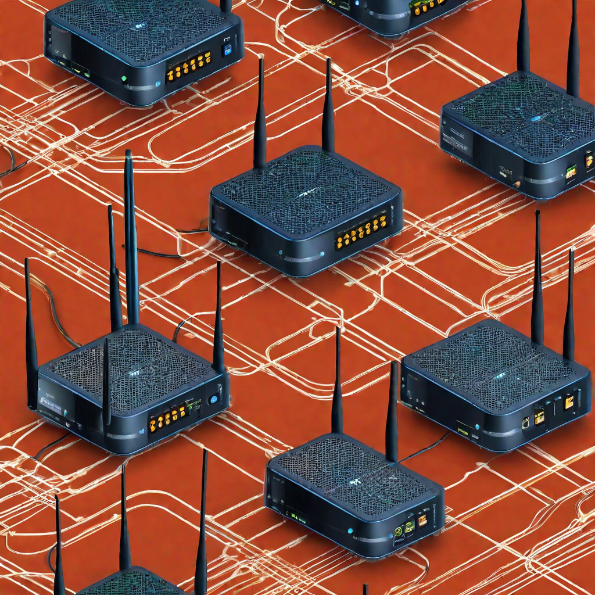
Implementing OSPF Routing with Single Area

Slide 2
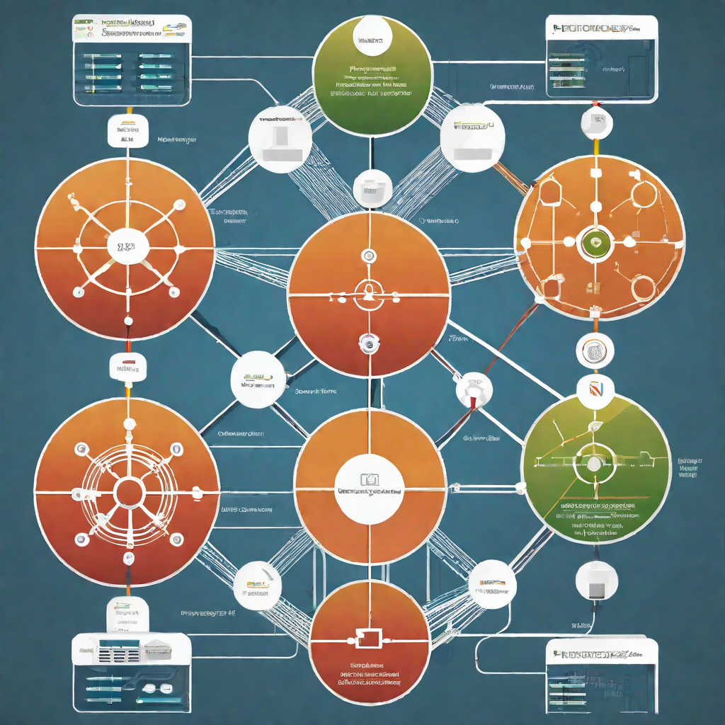
Introduction to OSPF
OSPF (Open Shortest Path First) is a popular routing protocol used in large enterprise networks. It is an interior gateway protocol (IGP) that is designed to efficiently distribute routing information within a single autonomous system (AS). OSPF is a link-state protocol that uses Dijkstra's algorithm to calculate the shortest path between two nodes on a network.
Advantages of OSPF
Fast convergence time
Scalability
Support for variable-length subnet masks (VLSMs)

Slide 3
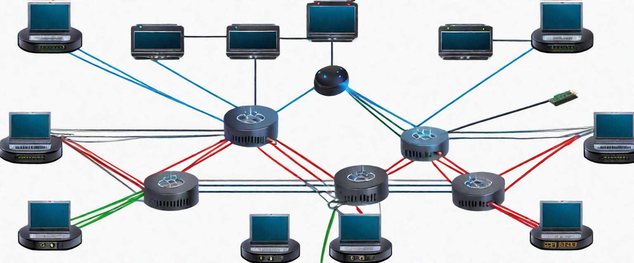
IP Addressing Scheme
Each router in the network has a unique class A IP address, with the first octet ranging from 1 to 6. The IP addresses are assigned as follows:
Router 1: 10.0.0.1
Router 2: 10.0.0.2
Router 3: 10.0.0.3
Router 4: 10.0.0.4
Router 5: 10.0.0.5
Router 6: 10.0.0.6

Slide 4
Configuring OSPF
Step 1: Assign IP Addresses
Step 2: Enable OSPF
Before configuring OSPF, you must assign IP addresses to each interface on your routers. Make sure to use class A IP addresses for your network.
Once your IP addresses are assigned, you can enable OSPF on each router using the 'router ospf' command in global configuration mode. You will also need to specify the process ID for OSPF.

Slide 5
Configuring OSPF
Step 3: Configure Interfaces
Step 4: Verify OSPF Configuration
Next, you will need to configure the interfaces on each router that will participate in OSPF. Use the 'network' command in router configuration mode to specify which interfaces will be part of the OSPF network.
After configuring OSPF on your routers, use the 'show ip ospf neighbor' command to verify that OSPF is running correctly and that all routers are communicating with each other.

Slide 6
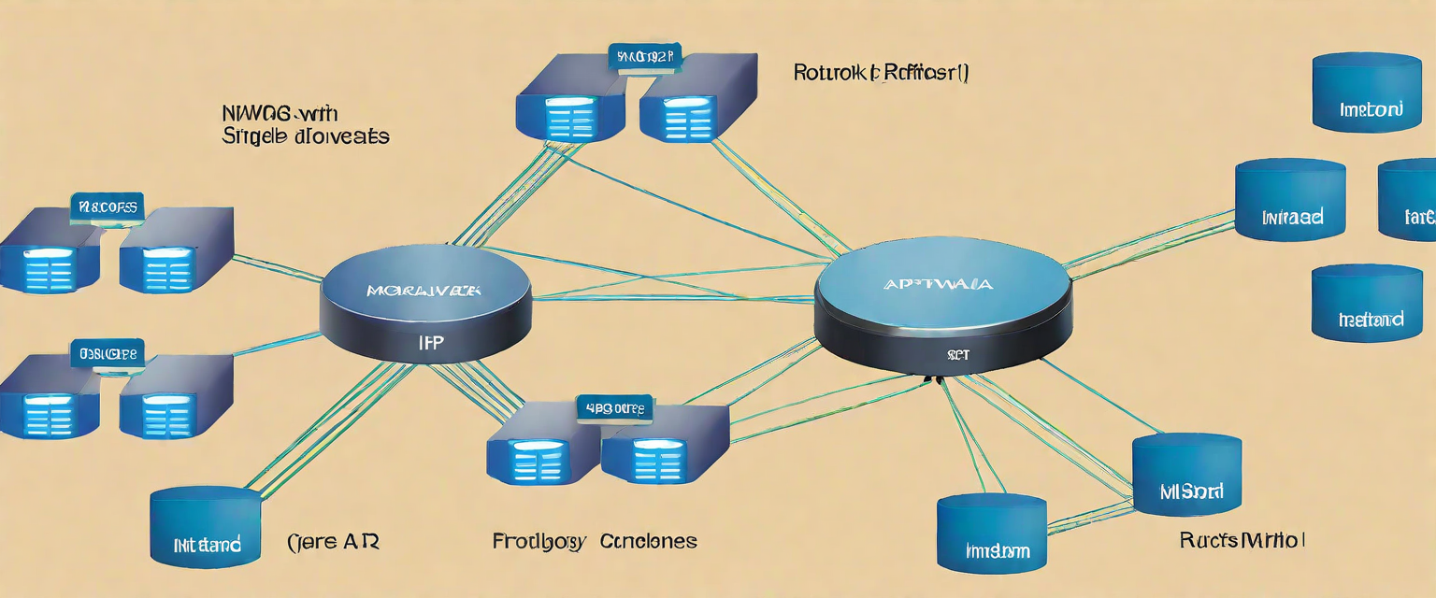
Verifying OSPF Configuration
Checking OSPF Neighbors
Use the following command to check if OSPF neighbors are established:
show ip ospf neighbor
Checking OSPF Routing Table
Use the following command to check the OSPF routing table:
show ip route ospf

Slide 7
Troubleshooting OSPF
Verify Network Connectivity
Check that all routers are powered on and connected to the network. Verify that interfaces are up and have the correct IP addresses assigned.
Check OSPF Configuration
Verify that the OSPF configuration is correct on all routers. Check that the network statements match the network topology and that the router IDs are unique.
Check OSPF Neighbors
Verify that all routers have formed OSPF adjacencies with their neighbors. Check that the neighbor IDs and IP addresses match on both sides of the adjacency.

Slide 8
Conclusion
In conclusion, this network project has been a valuable learning experience in configuring and managing a complex network infrastructure. Through the setup of six interconnected routers, we have gained practical insights into network design, configuration, and routing. The implementation of OSPF routing protocol allowed us to establish efficient communication between the routers, ensuring data packets are delivered optimally across the network.
We have also explored the importance of IP subnetting, which aids in efficient IP address allocation and management within the network. Understanding the roles and functions of hardware components, such as routers, switches, cables, and interfaces, is essential for building a resilient network infrastructure. Overall, OSPF is a powerful routing protocol that can greatly benefit a network. By carefully planning, designing, and configuring
OSPF, we can create a robust and efficient network that meets the needs of our organization.

